Slide 1
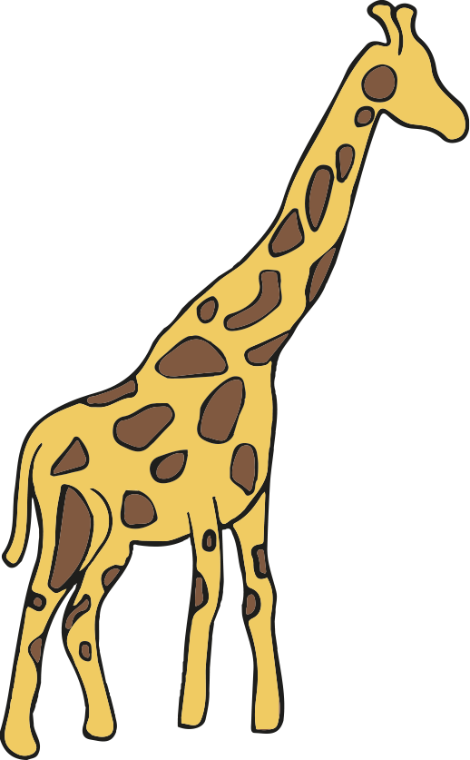
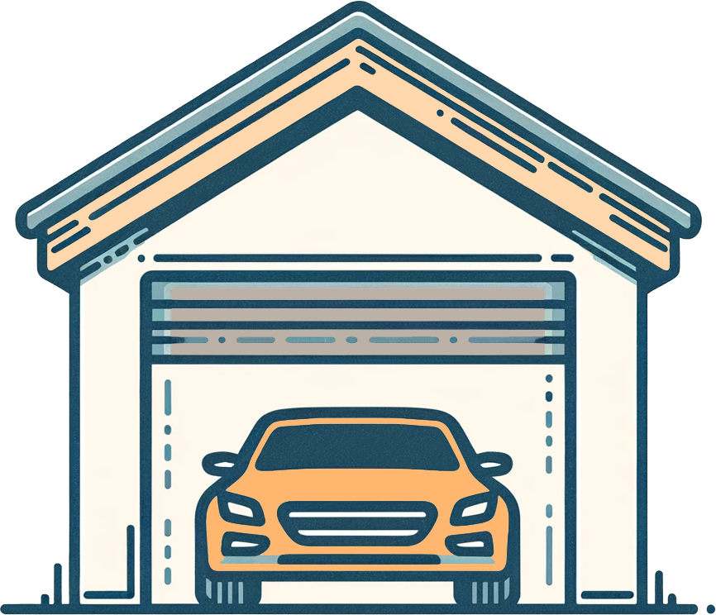


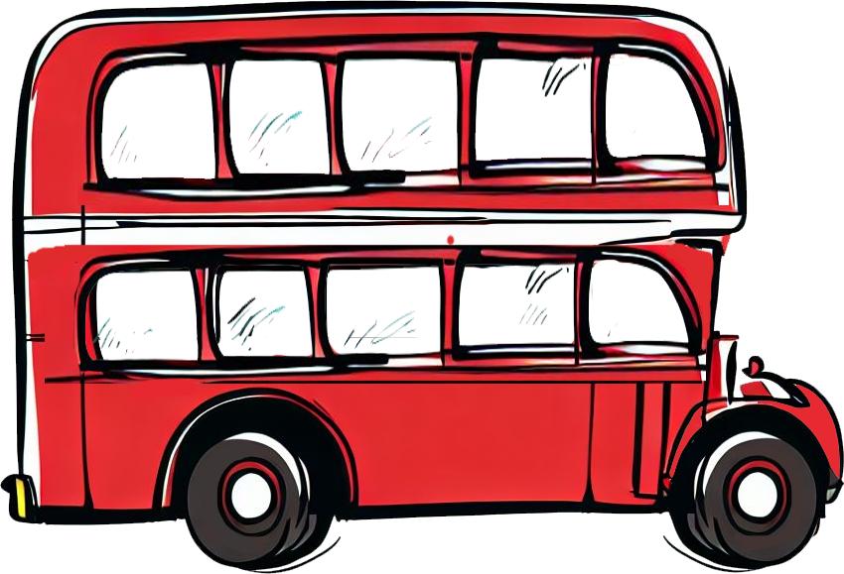
Direct proportion in context
Task A: Conversions
1) Write the following in order from the shortest to the tallest, using the conversion 1 m = 3.3 feet
Images are not to scale
5.1 m
14.2 feet
2.4 m
10.2 feet
13.2 feet
2)
Work out the maximum number of the boxes below that will fit into the box above.
a) A cube with dimensions of 40 mm b)
Images are not to scale
1.2 m
80 cm
1.6 m
0.04m
60 mm
4 cm
3) Fill in the missing values:
3.2 m² = cm²
125 000 cm² = m²
23 987 000 cm³ = m³
0.74 m³ = cm³
4) Calculate the area of this triangle. Give your answer to 2 decimal places in m².
86 cm
268 cm
254 cm

Slide 2

Direct proportion in context
5) Calculate the volume of this cuboid. Give your answer in cm³.
0.7 m
1.8 m
0.4 m
Task B: Other contexts involving direct proportion
1) Work out the following:
a) 23 pencils cost £14.95 How much will 34 pencils cost?
b) 14 rulers cost £5.18 How much will 20 rulers cost?
c) 17 sweets cost £2.55 How much will 37 sweets cost?
d) 27 chocolate bars cost £11.07 How much will 39 chocolate bars cost?
2) Andeep is comparing prices of sunglasses in the UK, the USA and France.
Rank the following from cheapest to most expensive.
£1 : $1.28
£1 : €1.18
£48.00
$60.80
€57.23

Slide 3
Direct proportion in context
3) Calculate the ingredients needed for the following numbers of cookies.
a) 18 cookies
Recipe for 15 cookies
75 g butter
125 g sugar
125 g flour
100 g chocolate chips
b) 72 cookies
c) 6 cookies
d) You have plenty of sugar, flour and chocolate chips, but only 1 kilogram of butter. What is the largest number of cookies you can make?
Mathematics in Education and Industry
v2.3

